Slide 1
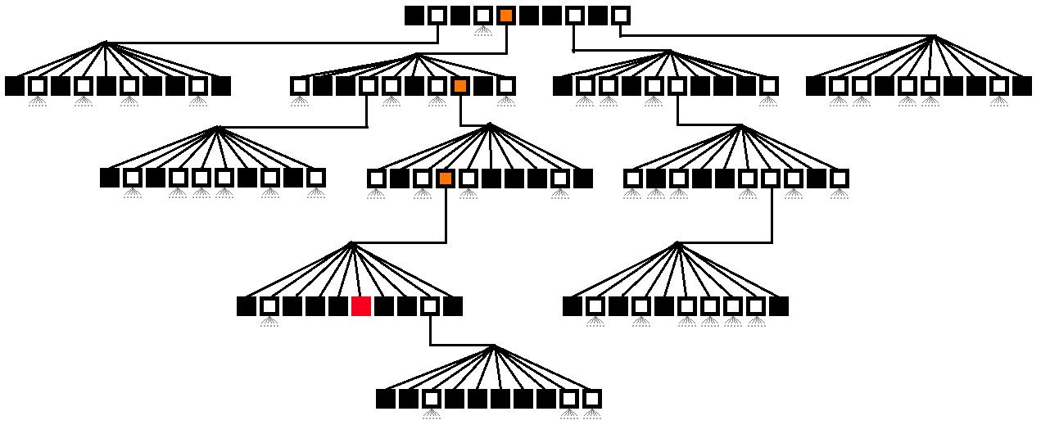
Tree
Dr. Sheak Rashed Haider Noori
Assistant Professor
Daffodil International University

Slide 2
Tree
Trees are very flexible and powerful non-liner data structure that can be used to represent data items possessing hierarchical relationship between the grand father and his children and grand children as so on.
A tree is an ideal data structure for representing hierarchical data.
A tree can be theoretically defined as a finite set of one or more data items (or nodes) such that :
There is a special node called the root of the tree.
Removing nodes (or data item) are partitioned into number of mutually exclusive (i.e., disjoined) subsets each of which is itself a tree, are called sub tree.
Before we begin our study of tree data structures, let’s look at a few common examples.

Slide 3
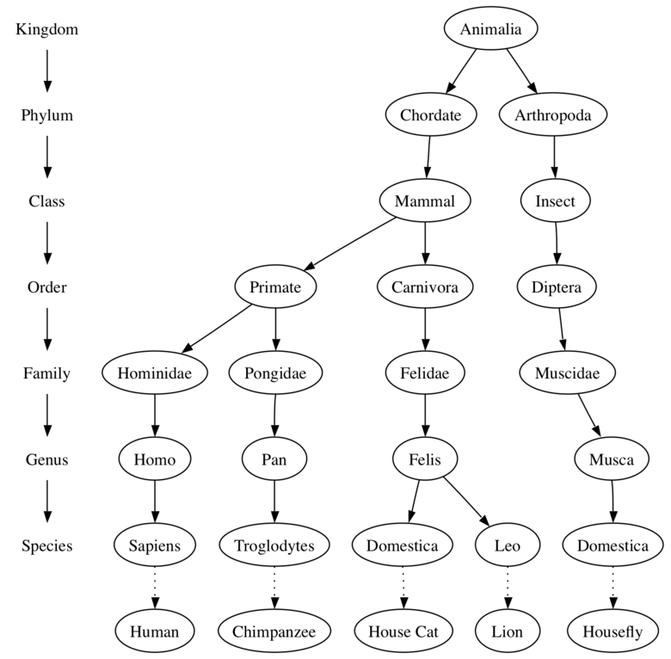
Examples of Trees
Our first example of a tree is a classification tree from biology.
Figure 1: Taxonomy of Some Common Animals Shown as a Tree

Slide 4
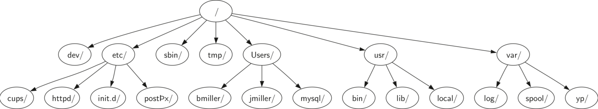
Examples of Trees
Another example of a tree structure that you probably use every day is a file system.
In a file system, directories, or folders, are structured as a tree.
Figure 2 illustrates a small part of a Unix file system hierarchy.
Figure 2: A Small Part of the Unix File System Hierarchy

Slide 5
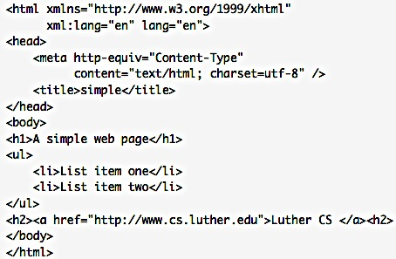
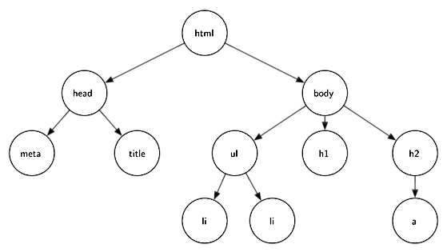
Examples of Trees
A final example of a tree is a web page. The following is an example of a simple web page written using HTML.
Figure shows the tree that corresponds to each of the HTML tags used to create the page.
Figure 3: A Tree Corresponding to the Markup Elements of a Web Page

Slide 6
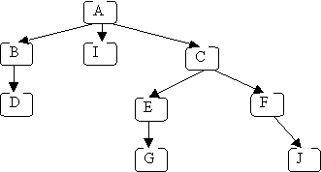
Basic Terminologies
Figure 4: Picture of a tree of letters.
Node : A node is a fundamental part of a tree. Each letter represents one node
It can have a name.
A node may also have additional information.
Edge : the arrows from one node to another are called edges
An edge connects two nodes to show that there is a relationship between them.
Every node (except the root) is connected by exactly one incoming edge from another node.
Each node may have several outgoing edges.

Slide 7
Basic Terminologies
Root : the topmost node (with no incoming edges) is the root.
The root of the tree is the only node in the tree that has no incoming edges.
Example
In Figure 4, node A is the root node of the tree
In Figure 2, / is the root of the tree.
Leaf Node : A leaf node is a node that has no children.
The bottom nodes (with no outgoing edges) are the leaves
Example
In Figure 4, nodes D, I, G & J are leaf nodes
in Figure 1, Human and Chimpanzee are leaf nodes.

Slide 8
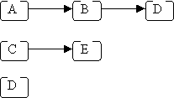
Basic Terminologies
Path : A path in a tree is a sequence of (zero or more) connected nodes;
Example, here are 3 of the paths in the tree shown in Figure:
The length of a path is the number of edges crossed in the path, e.g.:
For path A->B->D, length is 2
For path C->E, length is 1
For path D, length is 0

Slide 9

Basic Terminologies
Given two connected nodes like this:
Node A is called the parent, and node B is called the child.
Children
The set of nodes c that have incoming edges from the same node to are said to be the children of that node.
In Figure 2, nodes log/, spool/, and yp/ are the children of node var/.
Parent
A node is the parent of all the nodes it connects to with outgoing edges.
In Figure 2 the node var/ is the parent of nodes log/, spool/, and yp/.
Sibling
Nodes in the tree that are children of the same parent are said to be siblings.
The nodes etc/ and usr/ are siblings in the file system tree.

Slide 10
Basic Terminologies
Subtree: A subtree of a given node includes one of its children and all of that child's descendants.
The descendants of a node n are all nodes reachable from n (n's children, its children's children, etc.).
In the example Figure 4, node A has three subtrees:
B, D
I
C, E, F, G, J.
Level
The level of a node n is the number of edges on the path from the root node to n.
Example, the level of the Felis node in Figure 1 is five.
By definition, the level of the root node is zero.
Height
The height of a tree is equal to the maximum level of any node in the tree.
The height of the tree in Figure 2 is two.

Slide 11
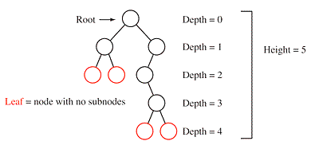
Basic Terminologies
Depth
depth tells the number of steps (nodes) to get from a node back to the root.
This tree has height 5, so the maximum depth is 4 (height - 1)

Slide 12
Tree cont.
Figure 5: A sample Tree of latters

Slide 13
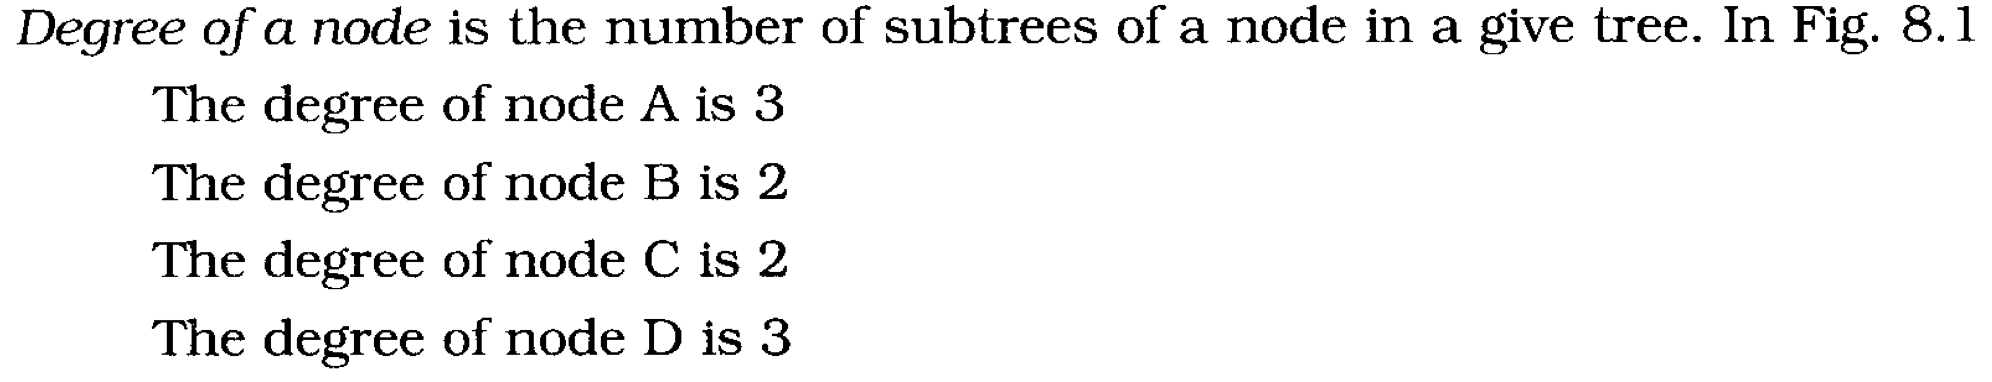
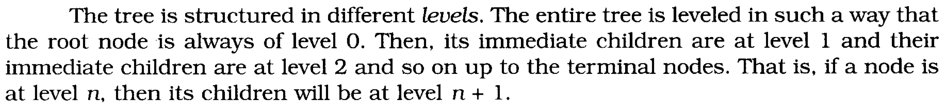
BASIC TERMINOLOGIES
Root is a specially designed node (or data items) in a tree. It is the first node in the hierarchical arrangement of the data items. ‘A’ is a root node in the Fig. 8.1. Each data item in a tree is called a node. It specifies the data information and links (branches) to other data items.
Figure 5

Slide 14
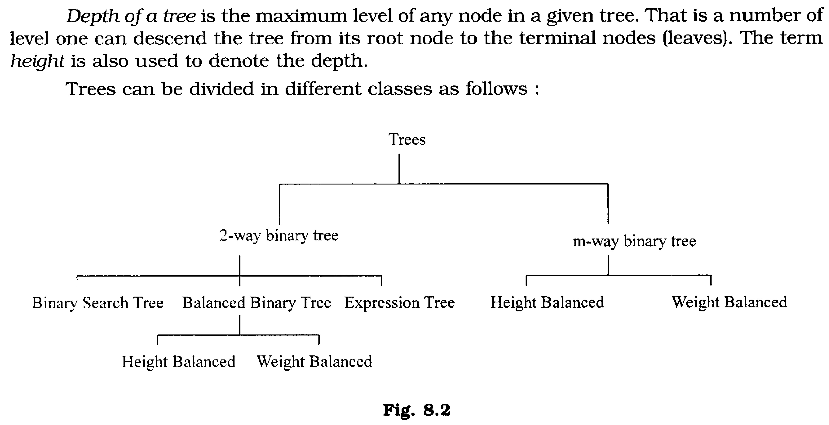
Classification of Tree

Slide 15
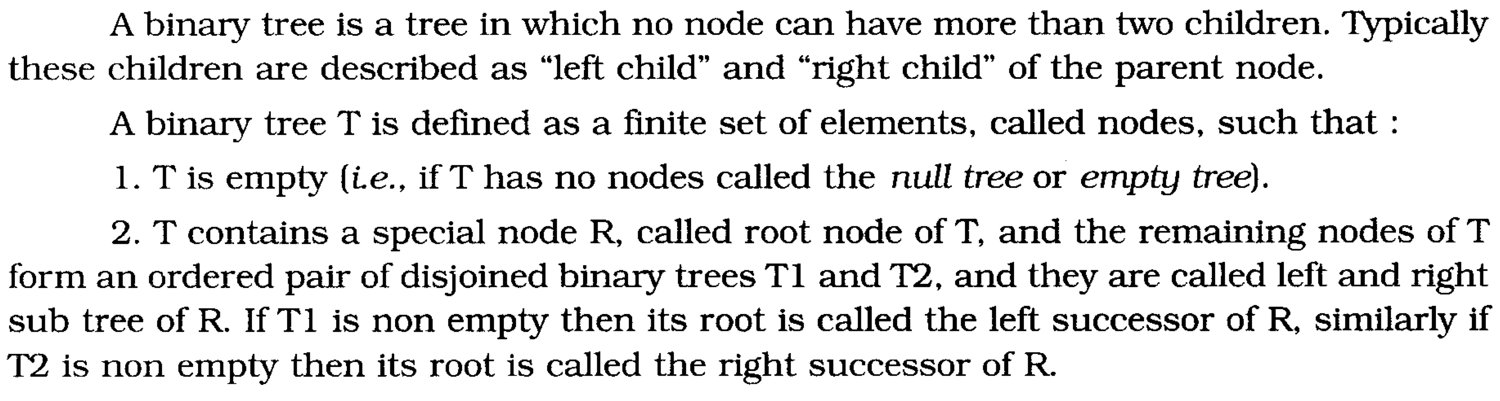
Binary Trees

Slide 16
Binary Trees

Slide 17
Strictly Binary Tree

Slide 18
Complete Binary Tree

Slide 19
TRAVERSING BINARY TREES

Slide 20
PRE ORDERS TRAVERSAL
To traverse a non-empty binary tree in pre order following steps one to be processed
Visit the root node
Traverse the left sub tree in preorder
Traverse the right sub tree in preorder
That is, in preorder traversal, the root node is visited (or processed) first, before traveling through left and right sub trees recursively.

Slide 21
IN ORDER TRAVERSAL
The in order traversal of a non-empty binary tree is defined as follows :
Traverse the left sub tree in order
Visit the root node
Traverse the right sub tree in order
In order traversal, the left sub tree is traversed recursively, before visiting the root. After visiting the root the right sub tree is traversed recursively, in order fashion.
The in order traversal of a binary tree in Fig. 8.12 is D, B, H, E, I, A, F, C, J, G.

Slide 22
POST ORDER TRAVERSAL
The post order traversal of a non-empty binary tree can be defined as :
Traverse the left sub tree in post order
Traverse the right sub tree in post order
Visit the root node
In Post Order traversal, the left and right sub tree(s) are recursively processed be- fore visiting the root.
The post order traversal of a binary tree in Fig. 8.12 is D, H, I, E, B, F, J, G, C, A

Slide 23
Inorder, Preorder and Postorder

